Slide 1
Artificial Intelligence in Modern Computing
Lab Task 05 - Academic Presentation
Submitted by: Muhammad Rehan (CMS: 608357)

Slide 2
Key Applications of AI
• Machine Learning & Deep Learning algorithms for predictive analysis.
• Natural Language Processing (NLP) in virtual assistants and chatbots.
• Computer Vision in medical imaging, autonomous vehicles, and security.
• Robotics and Automation in smart manufacturing and logistics.

Slide 3
Comparison of AI Domains
Domain | Primary Focus | Key Techniques
Machine Learning | Data Patterns & Predictions | Regression, Decision Trees, SVM
Deep Learning | Neural Network Architectures | CNN, RNN, Transformers
Computer Vision | Visual Data Understanding | Object Detection, Segmentation

Slide 4
Global AI Market Growth (in Billions USD)

Slide 5
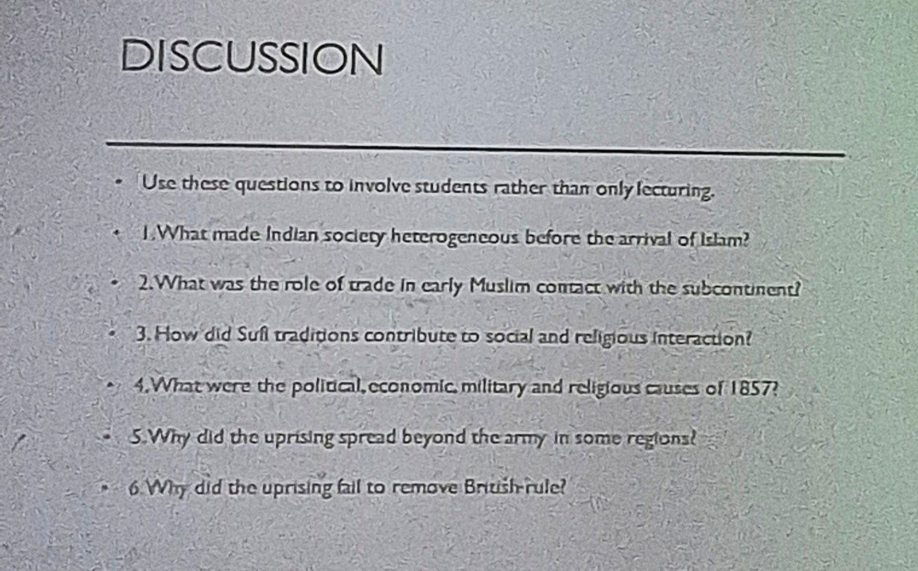
Image Random

Slide 6
Conclusion & Summary
AI continues to transform industries rapidly through data-driven decisions and advanced automation. Continued research and ethical deployment are essential for sustainable growth.

